Slide 1

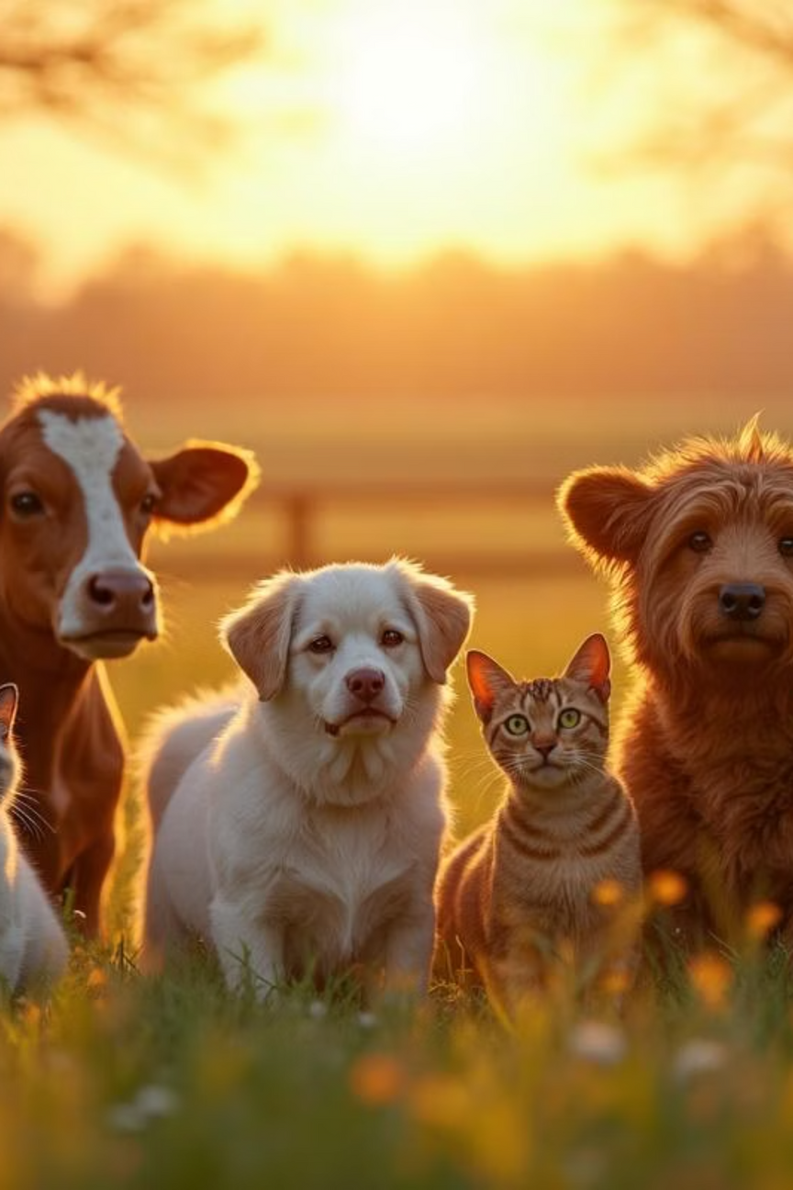
OneBowl
(One Bowl to Every Animal)
One bowl, endless compassion. Choose an animal, select their favorite food, and watch your kindness create a ripple of joy. Every meal matters, every donation feeds hope.One Bowl to every animal
Notes:
1

Slide 2

The Problem We're Solving
Millions of Animals Go Hungry Daily
Stray and shelter animals face constant hunger and malnutrition. Traditional donation methods lack transparency, making it difficult for donors to see their impact. Many caring individuals want to help but don't know where to start or how their contributions make a difference.
The gap between compassionate hearts and hungry animals needs a bridge - that's where OneBowl comes in.
Notes:
2

Slide 3
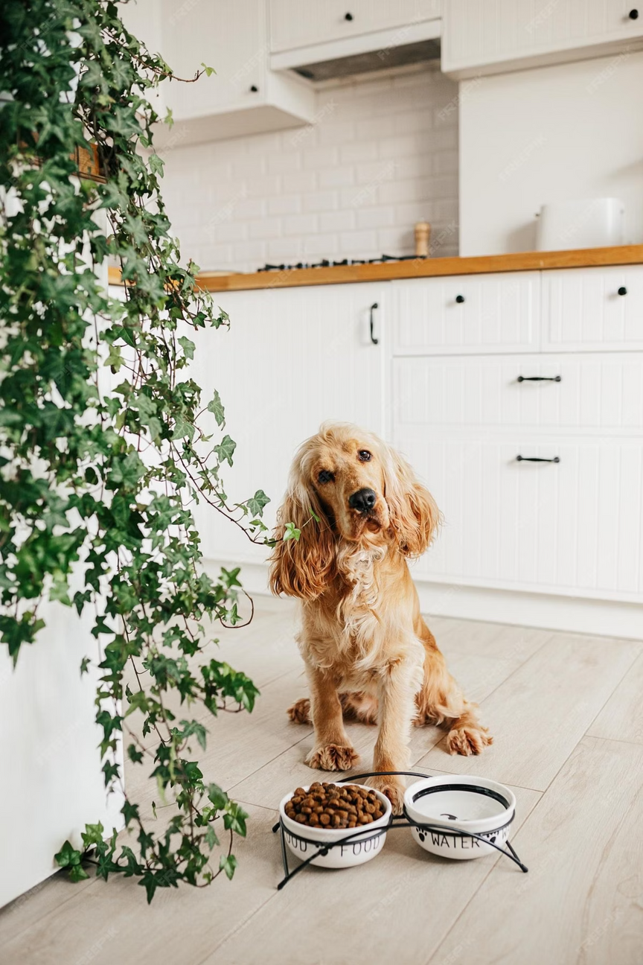

Our Solution: Transparent Animal Care
Easy Donations
Complete Transparency
Simple, user-friendly platform where anyone can donate food with just a few clicks. Choose your animal, select their meal, and make an instant impact.
Track your donation from payment to delivery with real-time updates, photos, and location tracking. See exactly where your kindness goes.
Verified Impact
Receive proof of delivery with photos and videos of animals being fed, plus personalized impact reports and certificates.
Notes:
3

Slide 4
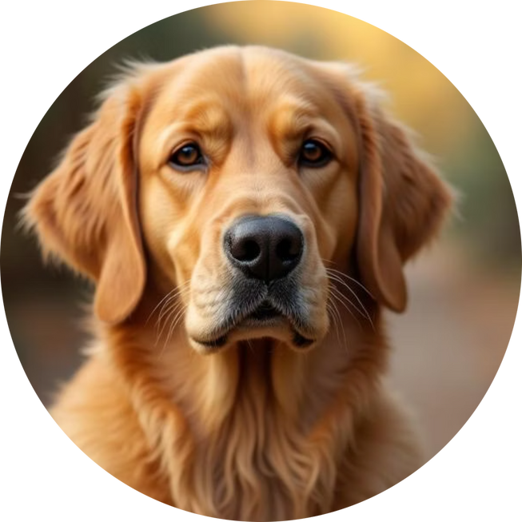
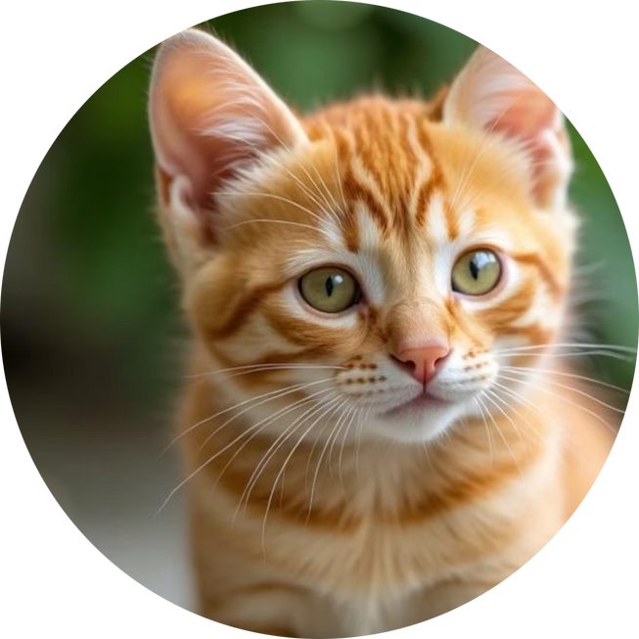
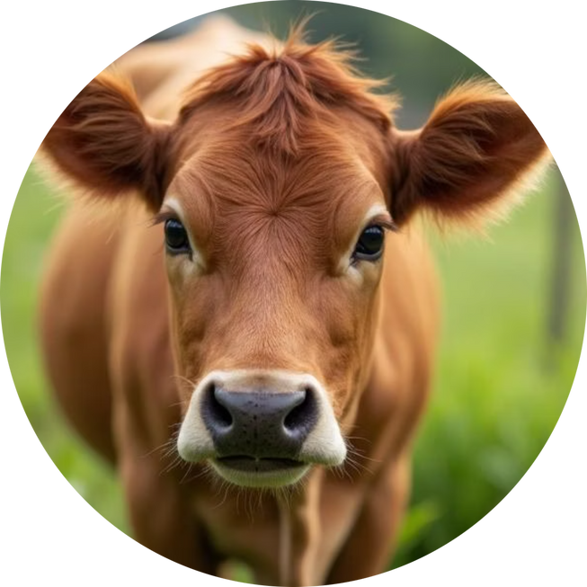
Choose Your Animal Friend
Every animal deserves love and care. Select your furry, feathered, or four-legged friend and help us bring them the nourishment they need.
Dogs 🐶
Cats 🐱
Cows 🐄
Biscuits, Pedigree, Milk +2 more options
Cat Food, Milk, Fish +1 more option
Hay, Grass, Grains +1 more option
Notes:
4

Slide 5
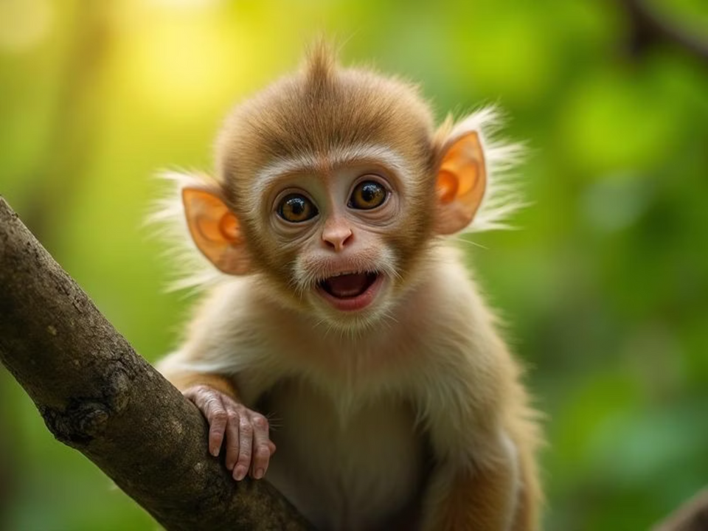
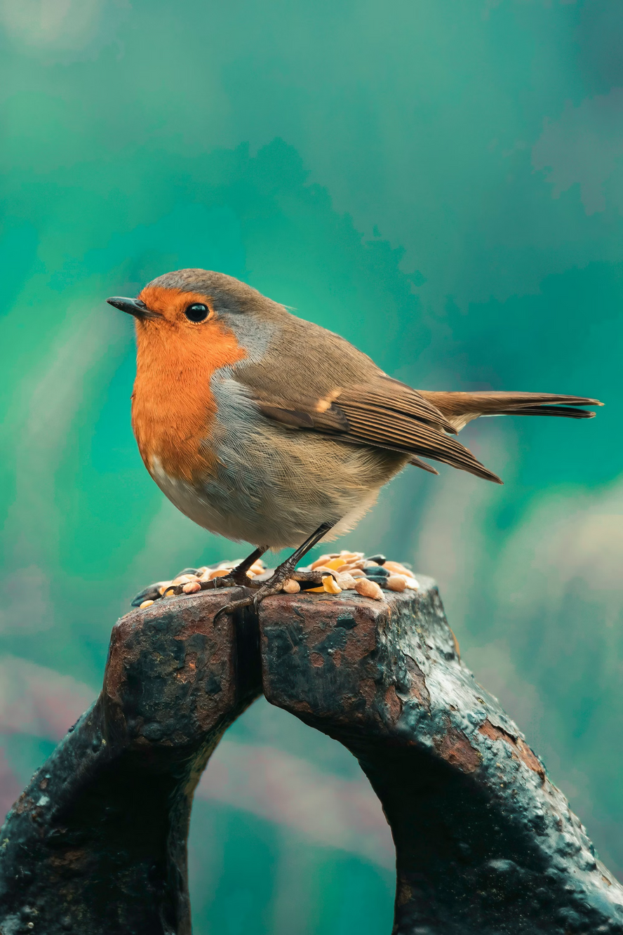
More Friends to Feed
Moneys 🐒
Birds 🐦
Seeds, Grains, Breadcrumbs , Millet + More
Bananas, Fruits, Nuts +1 more option available for our primate friends
More Friends to Added Soon
Birds 🐦
Seeds, Grains, Breadcrumbs +1 more option to keep our feathered friends happy
Each animal category offers carefully selected, nutritious food options that meet their specific dietary needs and preferences.
Notes:
5

Slide 6
How OneBowl Works
Making a difference is simple. Just a few steps between your kindness and a full belly.
01
02
Choose Your Friend
Pick Their Meal
Select which animal you'd like to help - dogs, cats, cows, or any other friend in need.
Browse food options perfect for your chosen animal and select the quantity you'd like to donate.
03
04
Make Your Donation
We Deliver
Secure payment through UPI, PayPal, or Razorpay. Choose to donate anonymously or with your name.
Our trusted partners purchase and deliver the food directly to animals in shelters and streets.
Notes:
6

Slide 7






Track Your Impact
Location Tracking
See the Impact
Impact Badges
See exactly where your food was delivered on a map with real-time tracking updates.
Receive photos and videos Live and also stored as user’s dashboard, showing your food being delivered and animals being fed.
Get personalized impact reports and certificates with impact badges for your contributions.
Notes:
7

Slide 8
Our Growing Impact
Every donation creates a ripple of kindness. Here's how we're making a difference together.
25
12
4
98%
Animals Fed
Kind Donors
Locations
Success Rate
This month alone, bringing nourishment and hope to hungry animals
Growing daily as more compassionate hearts join our mission
Across the city, expanding our reach to help more animals
Delivered with proof, ensuring transparency and trust
Notes:
8

Slide 9



Our Mission & Vision
Mission
Vision
To create a transparent, accessible platform that connects compassionate donors with hungry animals, ensuring every donation directly feeds those in need while building a community of animal lovers.
A world where no animal goes hungry, where technology bridges the gap between human kindness and animal welfare, creating lasting positive impact through simple acts of compassion.
Notes:
9

Slide 10
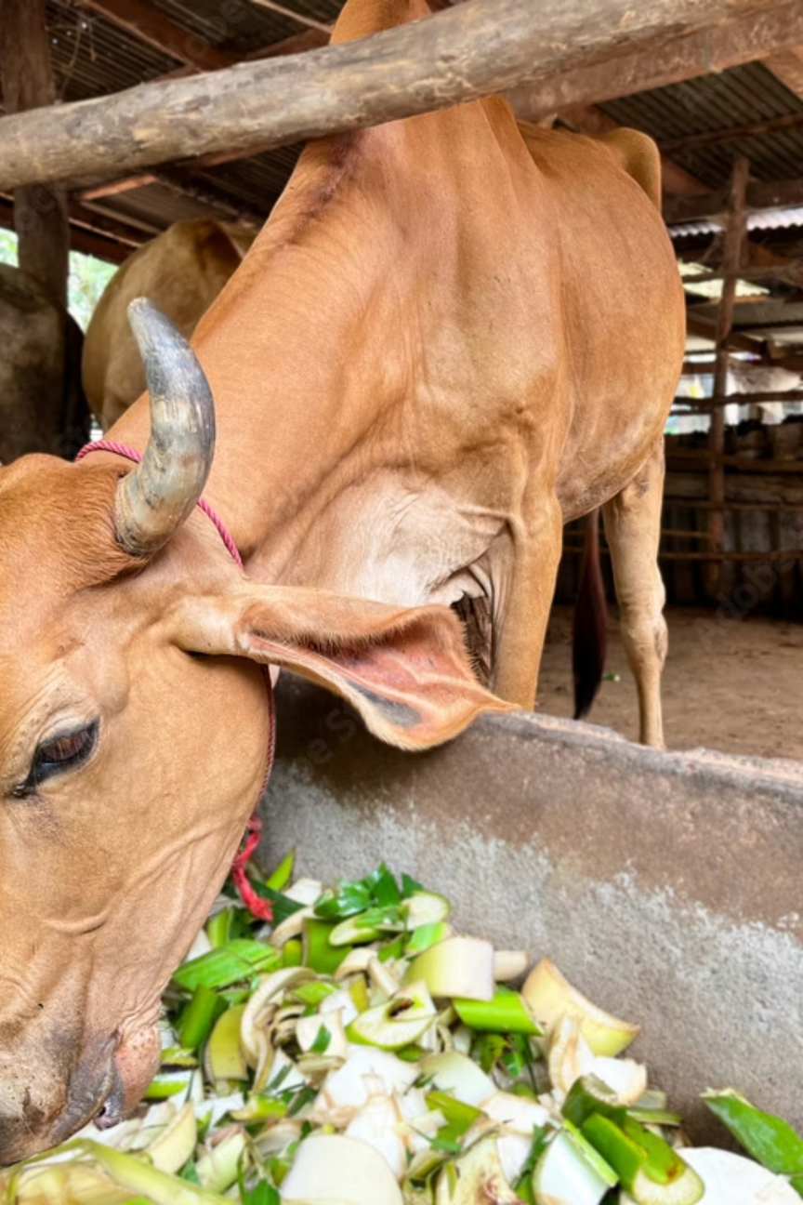

Feed Animals, Share Love
Join thousands of animal lovers making a real difference. Your donation doesn't just feed an animal - it feeds hope, spreads compassion, and creates a ripple of kindness that touches hearts across our community.
Every bowl filled is a heart touched. Every meal shared is love multiplied.
Notes:
10

Slide 11
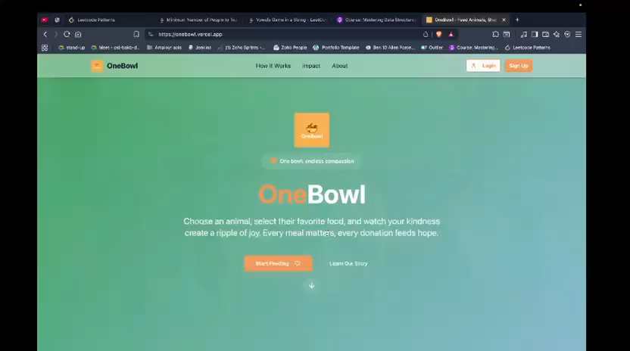
Glance :
Visit Website
Video Link - Click here to play video
Notes:
11

Slide 12
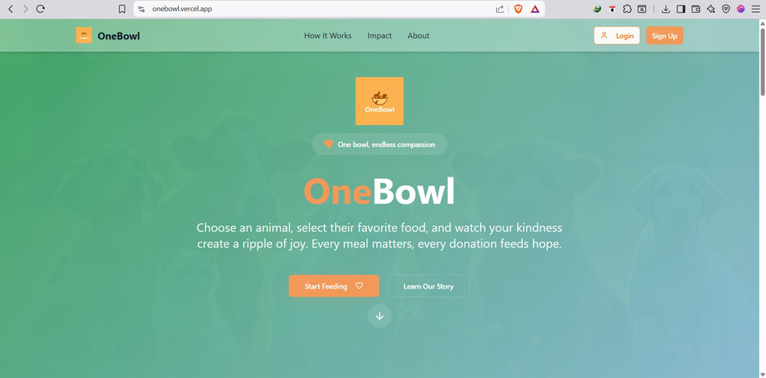
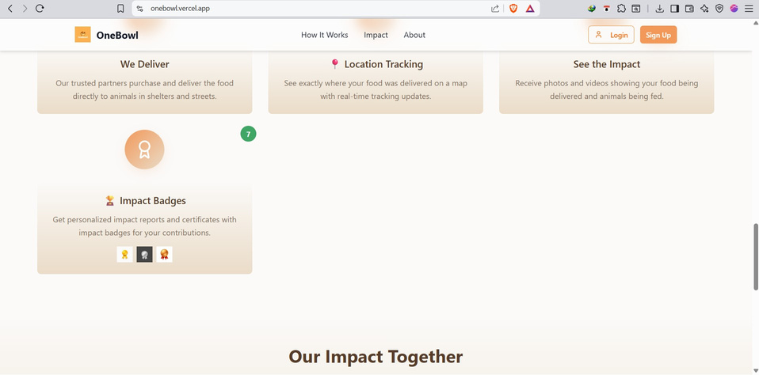
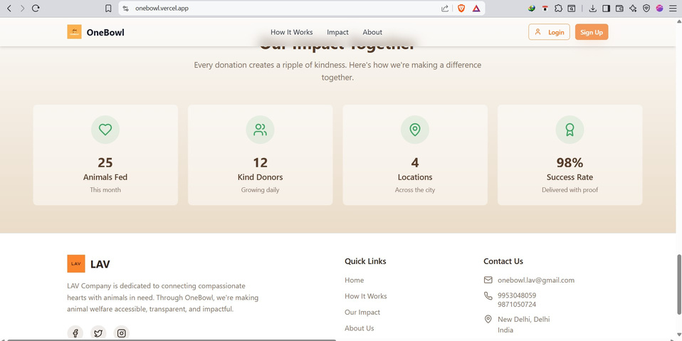
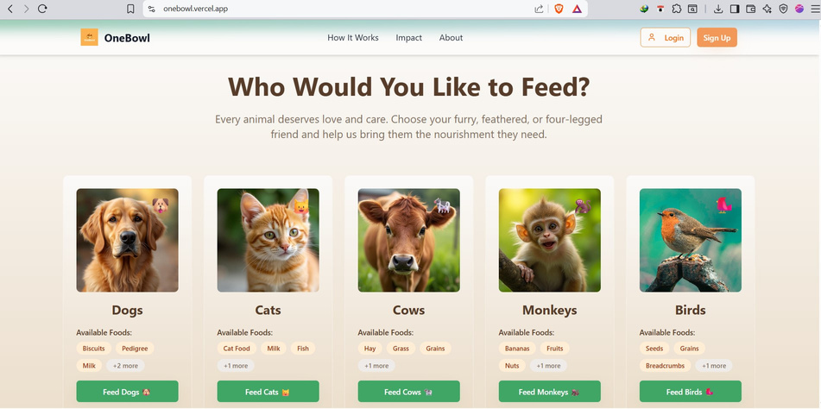
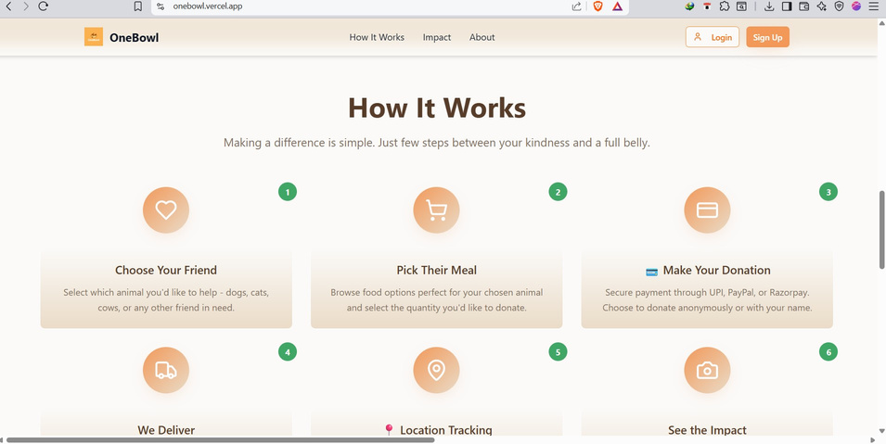
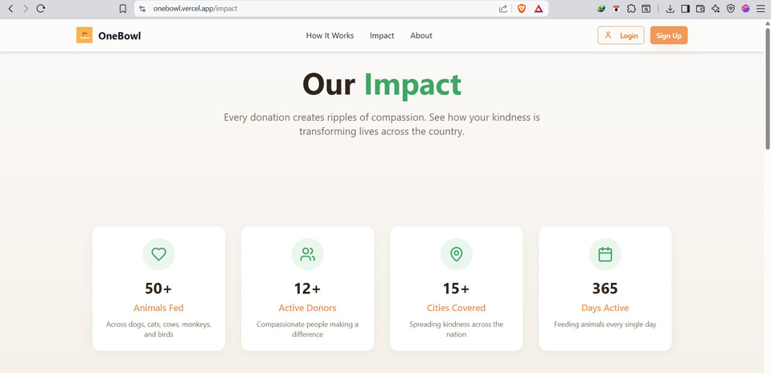
Glimpses :
Visit Website
Notes:
12

